Slide 1
Lesson objective
Need whiteboards and calculators
Title: Inverse operations
Aim
Be able to:
Calculate the radius or diameter of a circle given its circumference or area.
Plan:
Review area of composite shapes
Review key features of a circle
Inverse operations

Slide 2
Perimeter Vs. Area
10m
6m
6m
12m
10m

Slide 3
DRNS
Calculate the area:
D
R
N
S
6m
5m
10m

Slide 4
DRNS
Calculate the area:
D
R
N
S
11mm
22mm

Slide 5
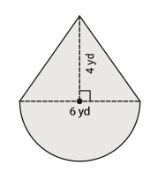
Composite shapes
Identify and label each shape
Calculate area of each shape (4d.p)
Add or subtract area for answer (2 d.p)
Shape A
Shape B
D
R
N
S

Slide 6
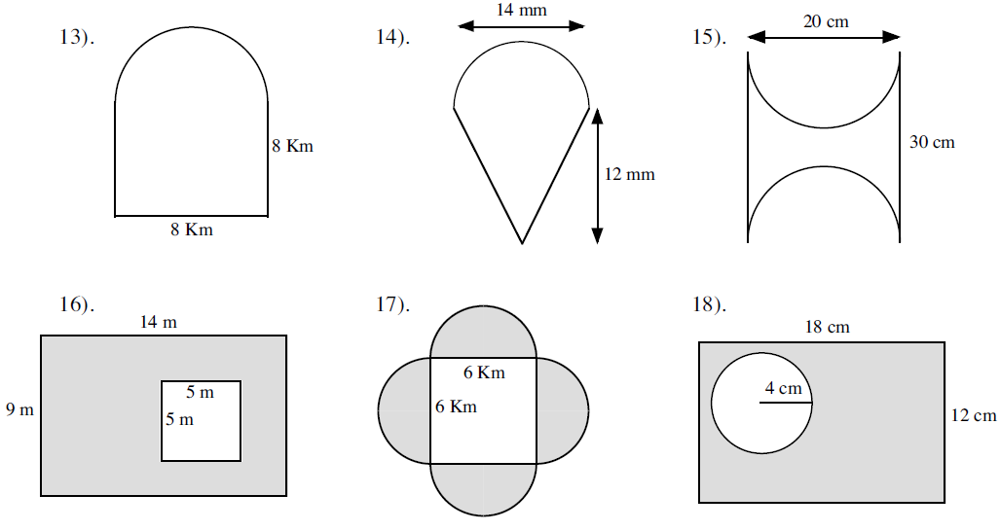
Whiteboards
Shape A
Shape B
D
R
N
S

Slide 7
Key features
Circumference
Circle edge/perimeter
Radius
From center of the circle to outside edge
Diameter
Straight line through the center, edge to edge
Diameter is twice the length of its radius

Slide 8
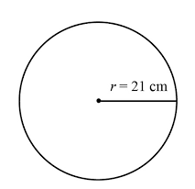
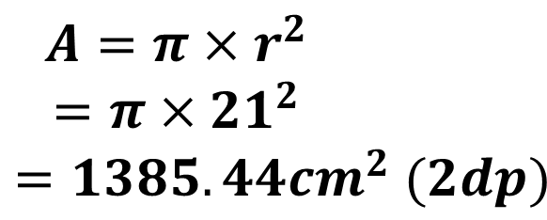
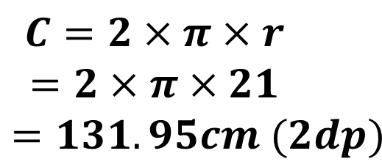
I DO
Aim: Practicing calculating area and circumference of a circle
Circumference: | Area:
$$C=2×π×r$$
$$=2×π×21$$
$$=131.95cm (2dp)$$
$$A=π×r^{2}$$
$$=π×{21}^{2}$$
$$=1385.44{cm}^{2} (2dp)$$

Slide 9
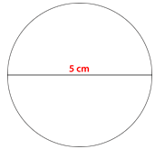
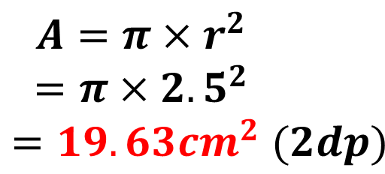
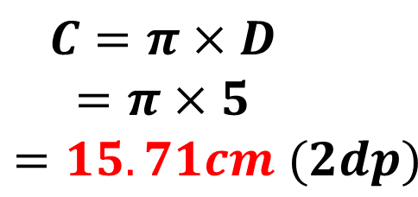
WE DO
Circumference: | Area:
$$C=π×D$$
$$=π×5$$
$$=15.71cm (2dp)$$
$$A=π×r^{2}$$
$$=π×{2.5}^{2}$$
$$=19.63{cm}^{2} (2dp)$$

Slide 10
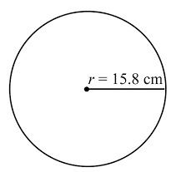
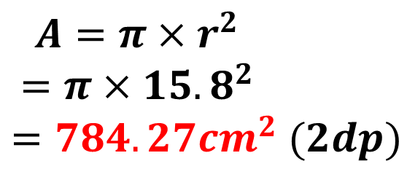

YOU DO
Whiteboards
Circumference: | Area:
$$C=2×π×r$$
$$=2×π×15.8$$
$$=99.27cm (2dp)$$
$$A=π×r^{2}$$
$$=π×{15.8}^{2}$$
$$=784.27{cm}^{2} (2dp)$$

Slide 11
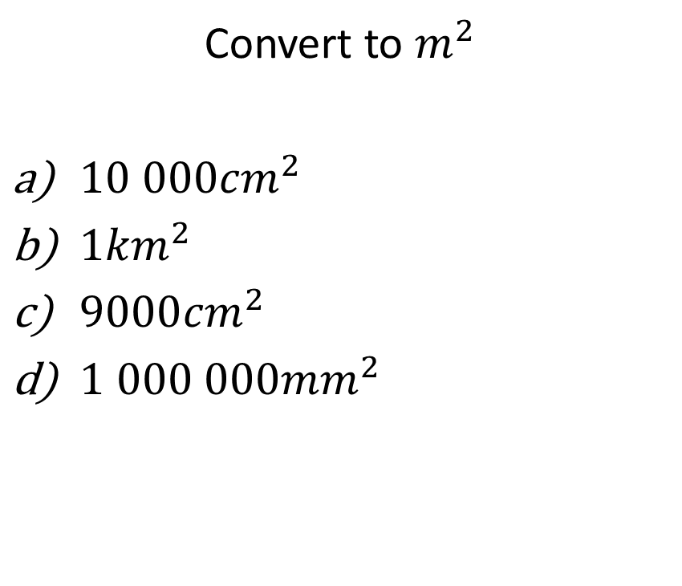
Converting length and area Revision
Convert to meters
100cm
500cm
1.2km
3000mm
Convert to $m^{2}$
${10 000cm}^{2}$
${1km}^{2}$
${9000cm}^{2}$
${1 000 000mm}^{2}$

Slide 12
Inverse problems
The reversal of an operation
What is the opposite of addition?
What is the opposite of multiplication?

Slide 13
Inverse operation task sheet

